Slide 1
Sustainability Flash Lab:
Why Is There a Furnace in the Middle of the Classroom?
TEACHING ABOUT CLIMATE CHANGE WORKSHOP
PENNSYLVANIA ENVIRONMENTAL RESOURCE CONSORTIUM
SUSQUEHANNA UNIVERSITY
Mark Collins
(after Orin Genderloos)
University of Pittsburgh
January 9, 2015

Slide 2
Acknowledgements
National Science Foundation, Award ID# 1240000, “Developing Highly Qualified Middle Grades Teachers with Expertise in STEM Disciplines” (J. Cartier, PI; with M. Bilec, M. Collins, D. Mosse, M. Smith)
Thanks to co-instructor Shaun Tomaszewski, TA Rylee Kercher, and the excellent students of GEOL 1904: Sustainability Flash Lab’s inaugural class, Spring 2014.

Slide 3
Origin
Developed by Orin Genderloos, UMich/Dearborn, part of “Concepts of Environmentalism” class
Immediate goals (according to Genderloos):
•Develop awareness of personal consumption
• Learn units of consumption

Slide 4
Class profile at Pitt
Elective course for environmental studies majors; first class capped at 22 (17 enrolled)
University of Pittsburgh: Large research university; environmental studies program is multidisciplinary B.A. major within Geology Department. (Note: city plays role in the class—more later)
Most students live in apartments—responsible for utilities for the first time

Slide 5
Random opening questions for students:
How much do you (your parents) pay for natural gas?
How much do you pay for electricity?
How much water do you use? (hilarious answers)
Students unaware of their own consumption rates, “typical” consumption rates, what affects consumption rates, how rates are measured, nor how consumption rates compare locally, nationally, or globally

Slide 6
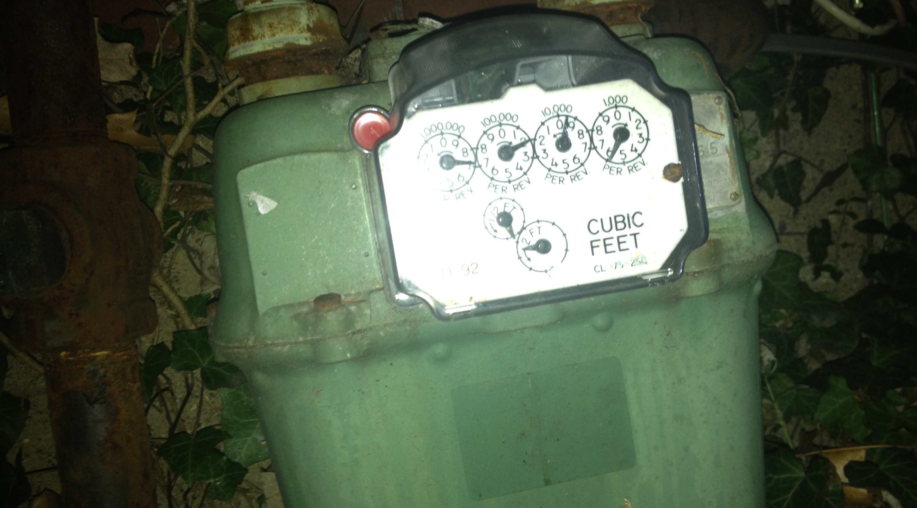
Weird Things in My House

Slide 7
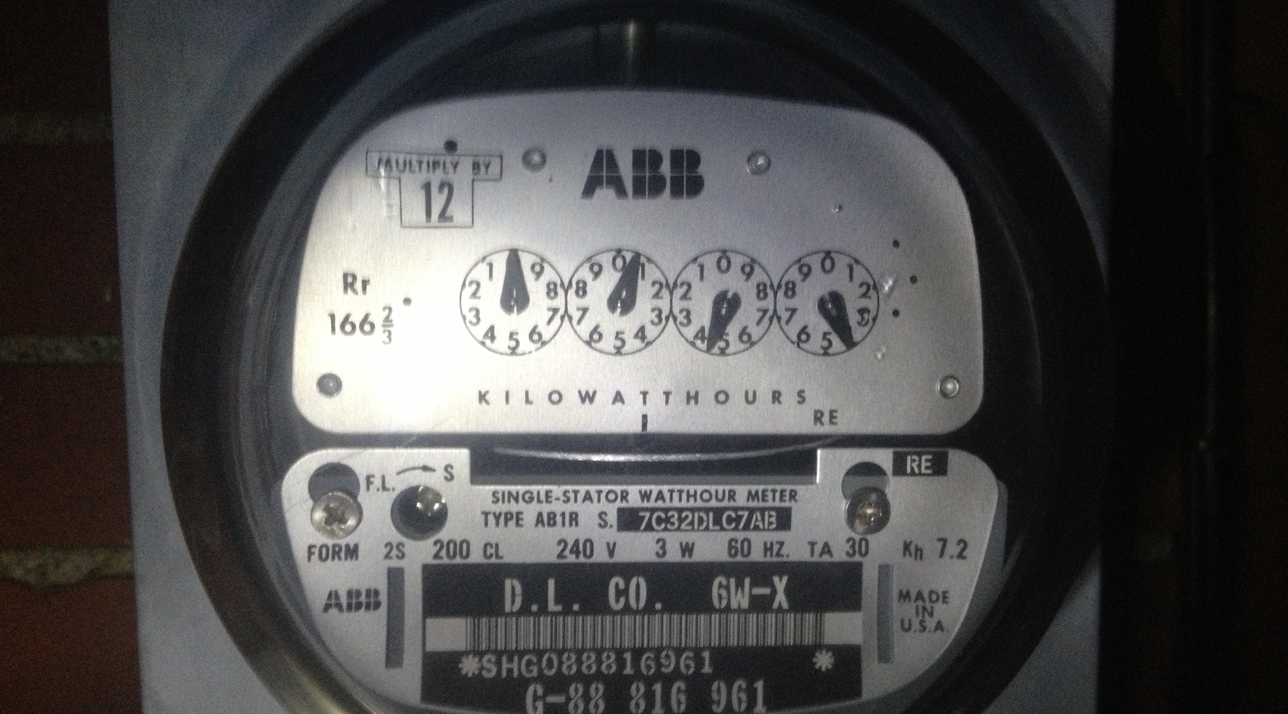
Weird Things in My House

Slide 8
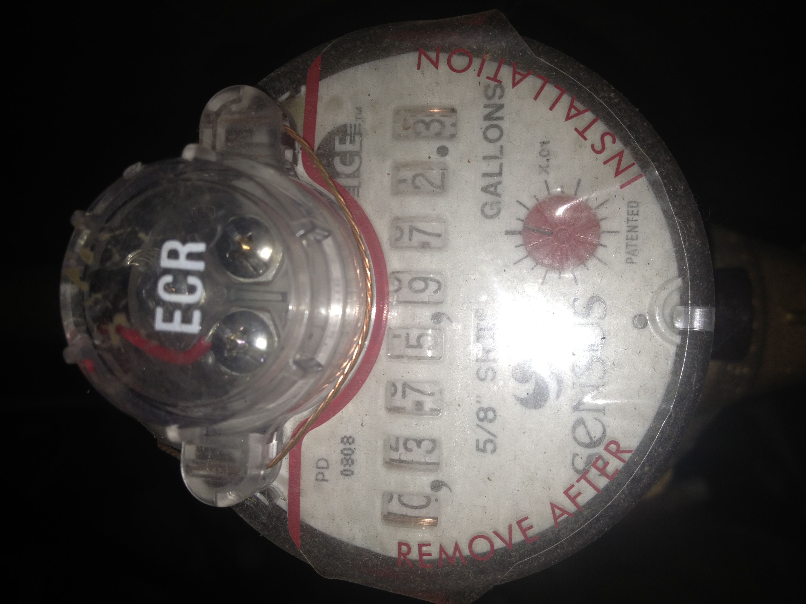
Weird Things in My House

Slide 9
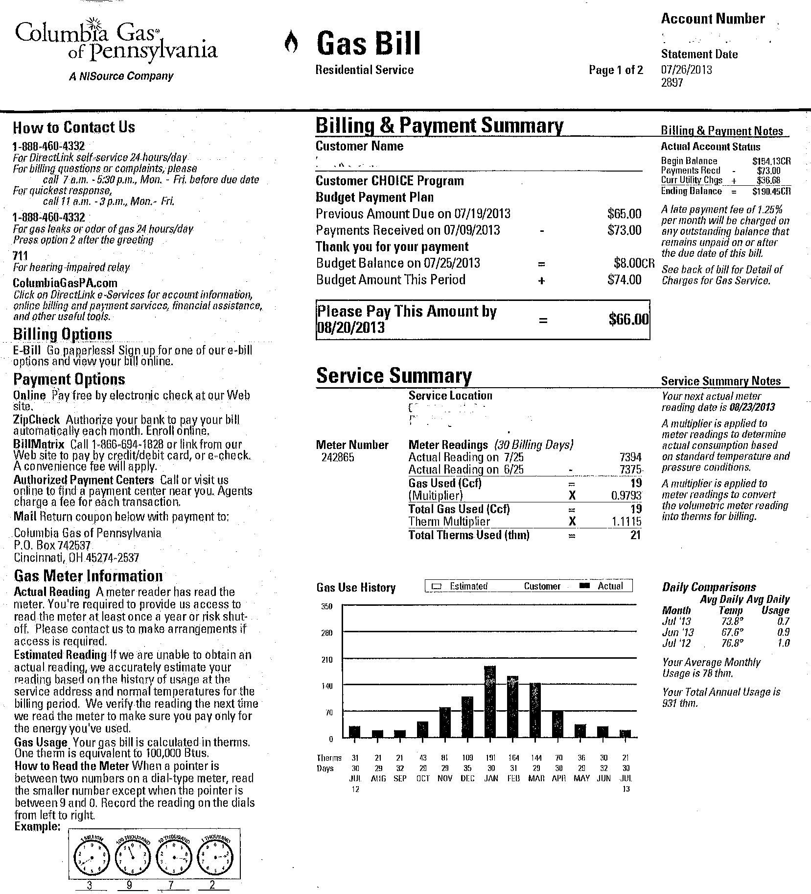
Weirdest Thing of All:

Slide 10
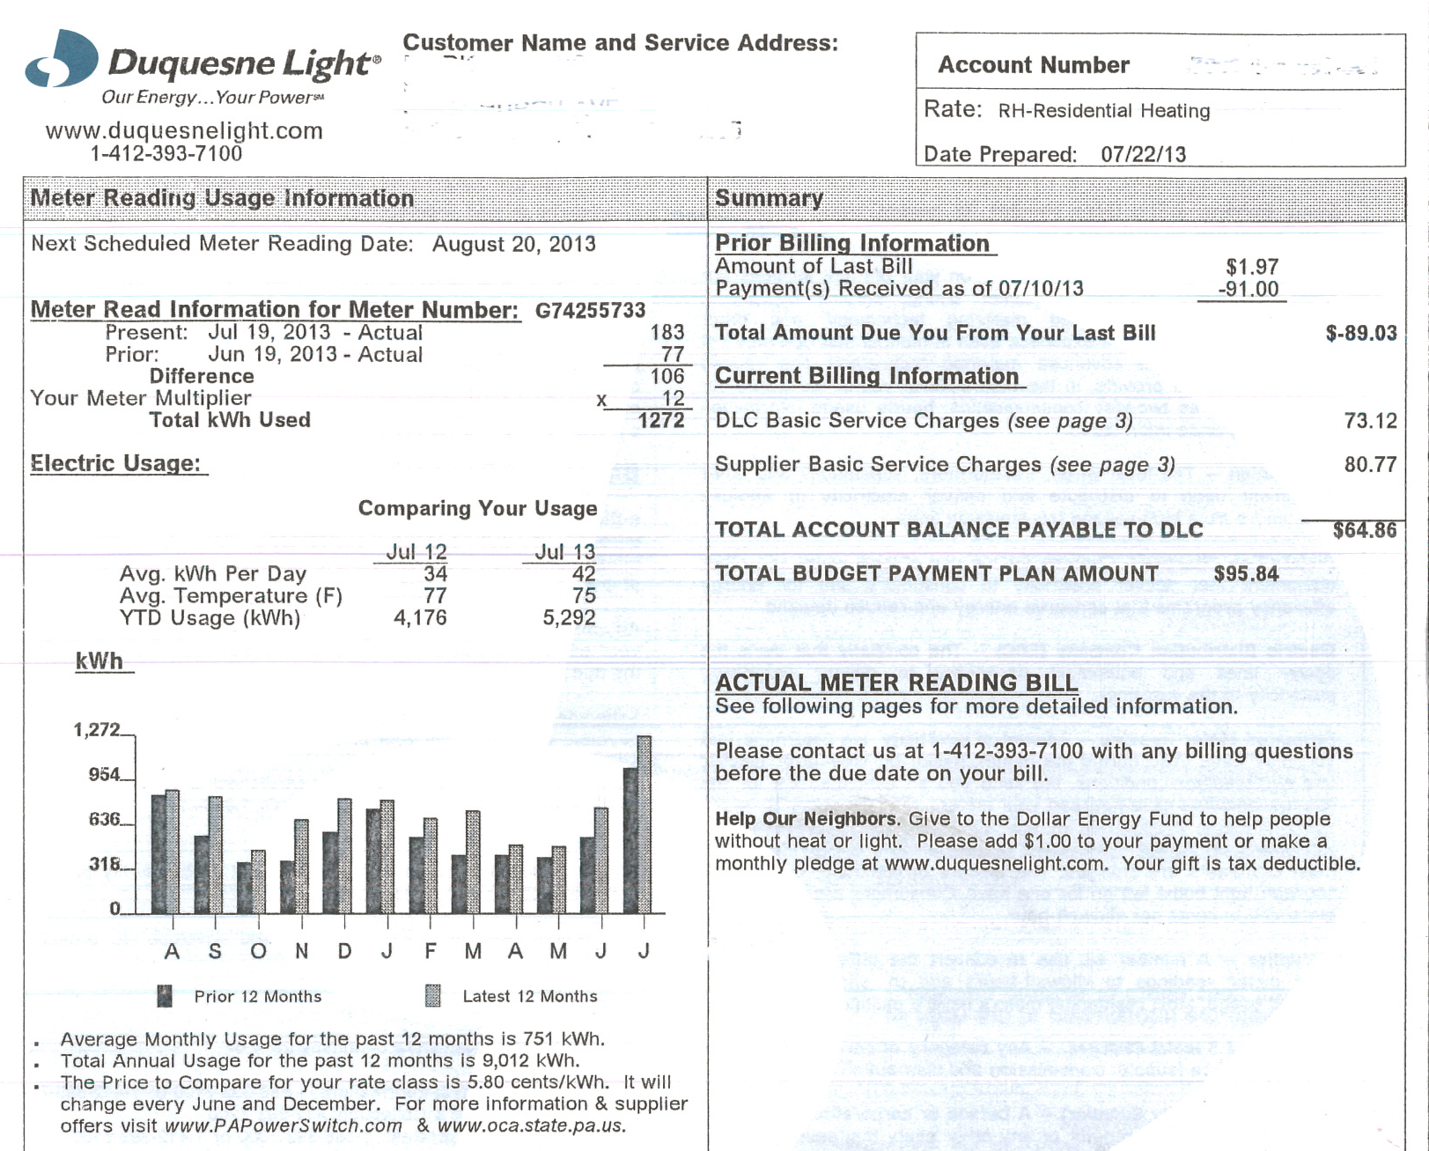
Weirdest Thing of All, #2

Slide 11
For starters: online energy audit greenninja.org
Use the score sheet below to calculate your total Energy Audit score (the lower the score, the better).
Light Bulbs: How many compact fluorescent light bulbs (CFLs) do you have?
None (6 pts)
1-4 (4 pts)
5 or more (2 pts)

Slide 12
Another sample online energy audit question: greenninja.org
Appliances: How many items (not including lights) plug into the wall on a daily basis?
15 or more (6 pts)
8 - 14 (4 pts)
7 or less (2 pts)

Slide 13
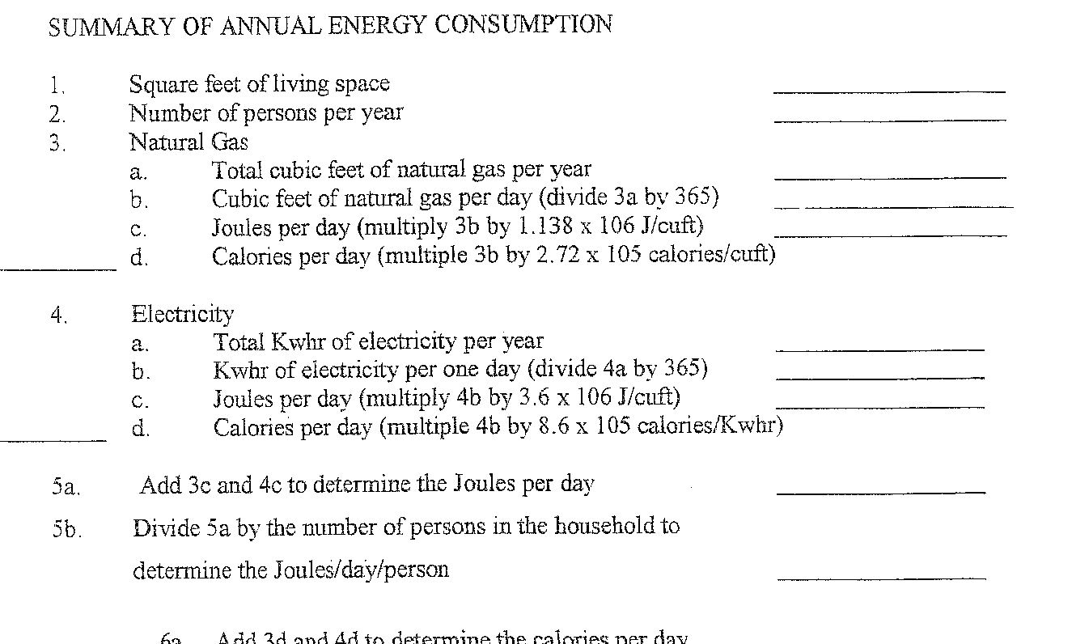
Instead: Household Systems Analysis survey (Genderloos)

Slide 14
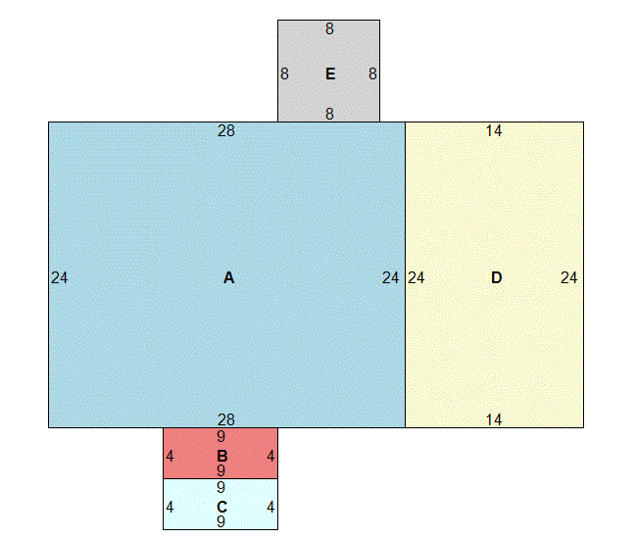
Calculating living space

Slide 15
Gas Bill as Example

Slide 16
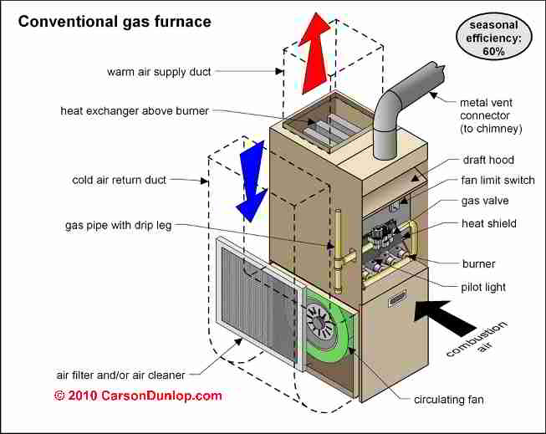
How does a furnace work?
(http://inspectapedia.com/heat/Furnaces.htm)

Slide 17
Gas Utility Bill: Factors (short list)
Geography / topography (shadow, valley, trees)
Time of year (hemisphere, latitude / longitude)
Degree days
Insulation, structure, materials, windows, etc.
occupation (vacation, work schedules, body heat)
programmable thermostat vs. regular (how does thermostat work? Variable speed furnace vs. single speed furnace? Who operates thermostat?)

Slide 18
Where does heat come from
(in PA, natural gas & oil)
fossil fuels (why?)
History (In PA: Drake’s well)
pipelines after World War II (some lines converted to natural gas = role in pollution control)
current pipelines
Marcellus

Slide 19
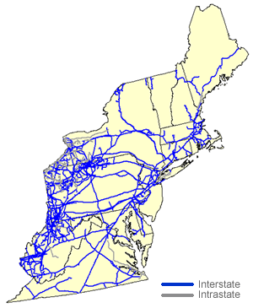
Gas Pipelines NE US

Slide 20
Implications, part deux
“Geography (History?) is Destiny”
•What are the implications of the physical place where you live?
•access to fuel
(Note availability of multiple types of fuel from multiple sources vs single type from single source)

Slide 21
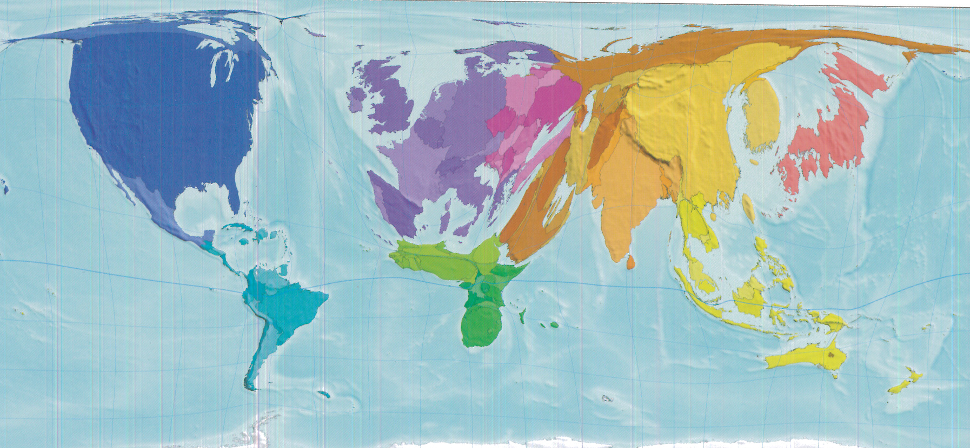
Fuel Use

Slide 22
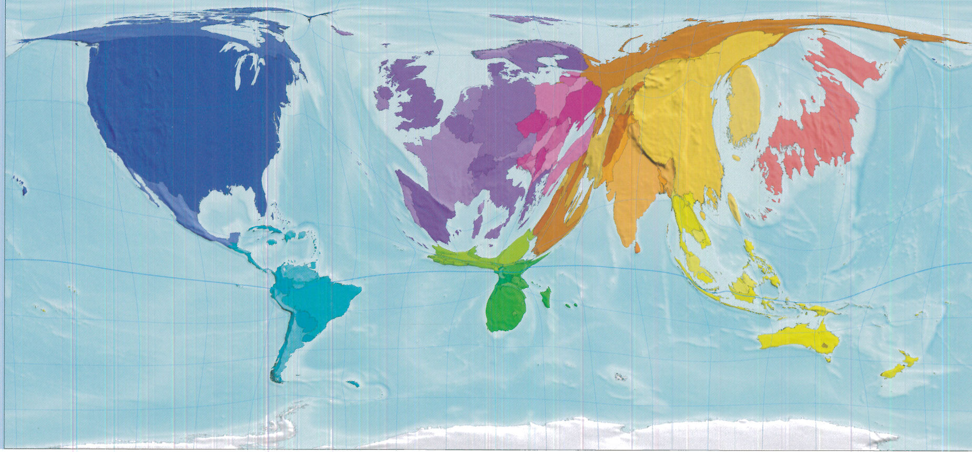
Electricity Production

Slide 23
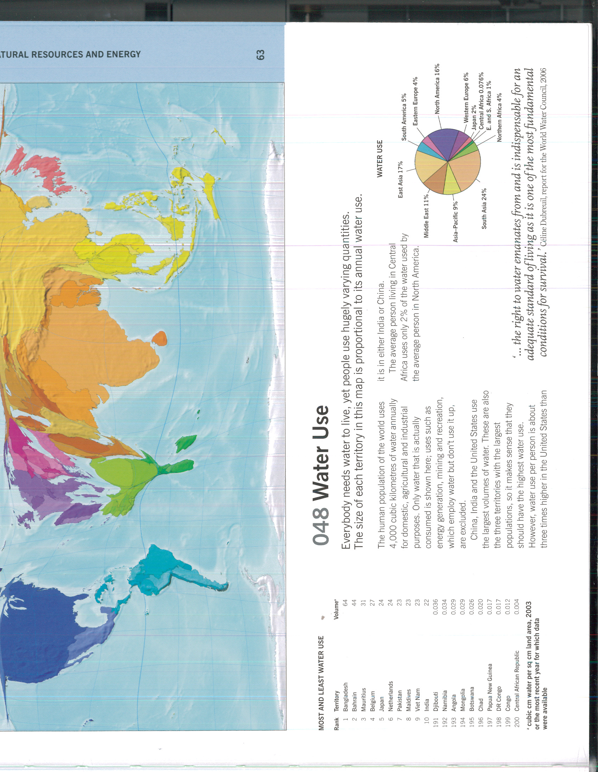
Water Use

Slide 24
Implications, part etc
•What are the implications of the physical place where you live—how you travel, how you eat, how supplies arrive where you live…more?

Slide 25
Expectation of Resources
(AKA outrageous acts of faith)
Turn the tap, water comes out. It will be safe to drink*
Gallon of gas at 89 octane will be a gallon of gas at 89 octane. How do we know that?
Infrastructure will be “up to code.”
Garbage will go…somewhere, where someone will take care of it, someplace else. Or something.
*probably it’ll be safe to drink. If not, why not?

Slide 26
Finally
Implications:
• individual behavior, ecological footprint
  (Note: college students aren’t excused because they’re college students. Neither are we.)
  • global consequences
  How we live
  How others live
  How we are intertwined
  FINAL PROJECT: personal resource audit/reduction

Slide 27
Results of Students’ Personal Resource Reduction
(All savings have been converted to per-month results):
Electricity (four students)
saved 0 kwh
saved 0 kwh
saved 33.24 kwh/month
saved 36 kwh/month
17.25 kw hours saved per month average per student

Slide 28
Results of Students’ Personal Resource Reduction
(All savings have been converted to per-month results):
Gasoline (two students)
5 gallons saved
3.28 gallons saved
4.14 gallons saved per month on average per student

Slide 29
Results of Students’ Personal Resource Reduction
(All savings have been converted to per-month results):
Water (six students)
saved 512 gal/month
  238 gals/month
  108 gals/month
  40 gals/month
  272 gals/month
  238 gals/month
384 gallons/month saved on average per student

Slide 30
Results of Students’ Personal Resource Reduction
(All savings have been converted to per-month results):
Garbage (three students)
garbage reduced by 37.5%
garbage reduced by 33%
garbage reduced by 50%
40% reduction on average per student

Slide 31
Additional modules
• electricity • transportation
• water • food
• sewage • conservation
• garbage • alternatives
• electronics

Slide 32
Sources
Dorling, Newman & Barford
The Atlas of the Real World: Mapping the Way We Live
Thames & Hudson, 2008

Slide 33
Questions?
mookie@pitt.edu

